Slide 1


Slide 2


User ID
Password
Forgot Password?
Login

Slide 3



Date and Time
Estate Name
Change Password
Edit Profile
Logout
Welcome Dr <name of doctor>
ID Search
Enter Patient ID
OR
Aadhaar Number
Biometric
Fields Search
Enter Patient Name
Date of Birth
Mobile Number
SEARCH
Add Patient
Patient ID | Name | DOB | Gender | Division | Challan | Line | Mobile Number | Aadhar No
1233 | xxxx
Register

Slide 4
Date and Time
Estate Name
Change Password
Edit Profile
Logout
Welcome Dr <name of doctor>
Filter
Permanent Workers
Temporary Workers
Dependents
Non Workers
Patient ID | Name | DOB | Gender | Division | Challan | Line | Mobile Number | Aadhar No
1233 | xxxx
1236 | xxxyy
Open
Open

Slide 5
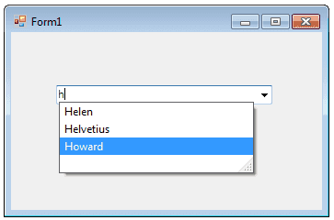
Date and Time
Estate Name
Change Password
Edit Profile
Logout
Welcome Dr <name of doctor>
Patient ID : …………………… Pres ID:……… Type: …………… Patient Name: …………………… Age: ………………
Health Profile Demographic and Contact Information Last Prescription
GENERAL CONSULTATION
PREGNANCY
VACCINATION
Signs and Symptoms
Cough, Cold, Fever
Investigations/ Tests
24-09-18 | Bllood RE
24-09-18 | Chest XRay
Add
Add
Diagnosis List
Viral Fever
Report Upload
View/ Add
Add
Final Summary
Medicines
24-09-18 | Calpol | BD | 5 Days
24-09-18 | Boroline | Apply Locally | 3 Days
24-09-18 | ABC Syrup | 10 ml
24-09-18 | Injec 1 | IV Stat
Sick
Days
Accident Approval
Admit
Add
Observation
New
Send to Pharmacy

